Slide 1
YEAR OF SAINT JOSEPH
Knights of Columbus
Ladies’ Program
Summer 2021

Slide 2
“WITH A FATHER’S HEART”
Apostolic Letter of Pope Francis: Patris Corde December 8, 2020 – December 8, 2021

Slide 3
In celebration of the 150th anniversary of Blessed Pope Pius IX’s declaration of St. Joseph as Patron of the Universal Church, Pope Francis has proclaimed a special “Year of St. Joseph.” It is a wonderful opportunity to increase our love for St. Joseph and knowledge, “to encourage us to implore his intercession and to imitate his virtues and his zeal”.
from Patris Corde

Slide 4
Faith Facts About Saint Joseph …

Slide 5
+ Only appearing in the Gospels of Matthew and Luke; Matthew provides his lineage of David + Saint Joseph never speaks a word from scriptural accounts + Present before, during and post-Nativity of the Lord Jesus, the Presentation of the child Jesus in the Temple and the Boy in the Temple (age 12) – no other mention of Saint Joseph in the scriptures + The circumstances and date of his death is unknown + Although already the patron saint of Mexico, Canada and Belgium, it was not until 1870 Saint Joseph was made the patron saint of the Universal Church (by Blessed Pope Pius IX) and later in 1955 Pope Pius XII established the feast of Saint Joseph the Worker on May 1st (to counter the Communist “May Day” + Saint Pope John XXIII inserted Saint Joseph into the Roman Canon on November 10, 1962 (n the middle of the 1st Session of Vatican Council II) + Pope Francis inserted Saint Joseph’s name into all the current Eucharistic Prayers of the Roman Missal III on June 18, 2013

Slide 6
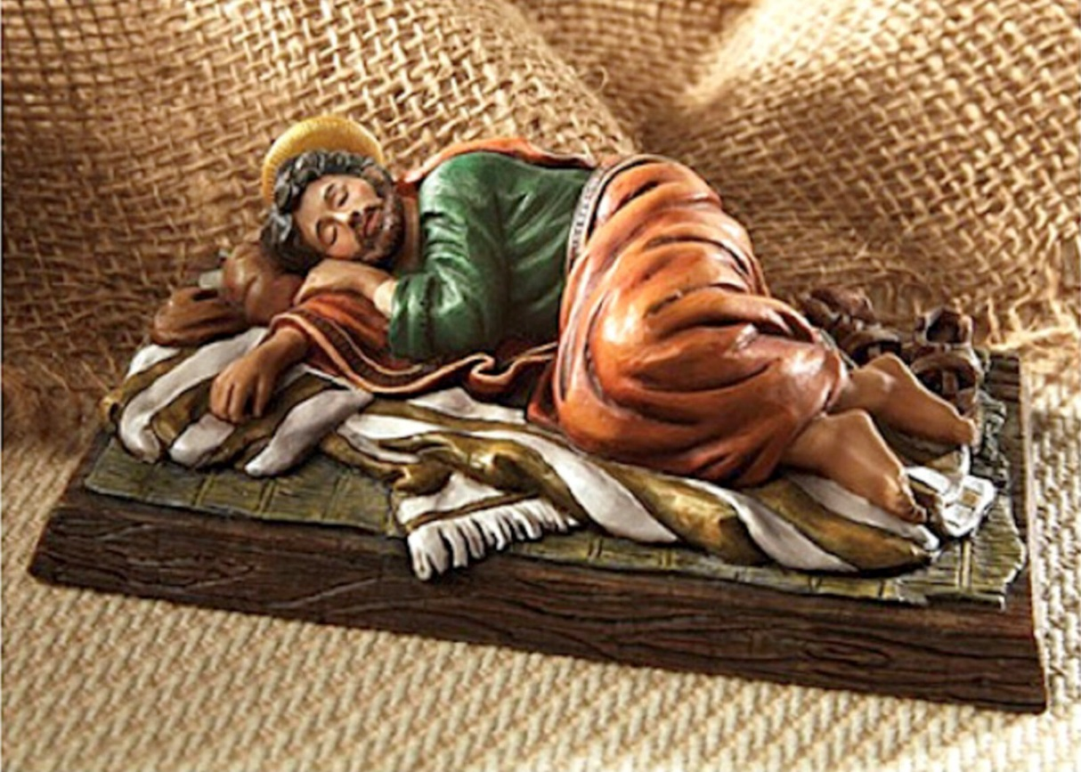
Sleeping Saint Joseph & Pope Francis

Slide 7
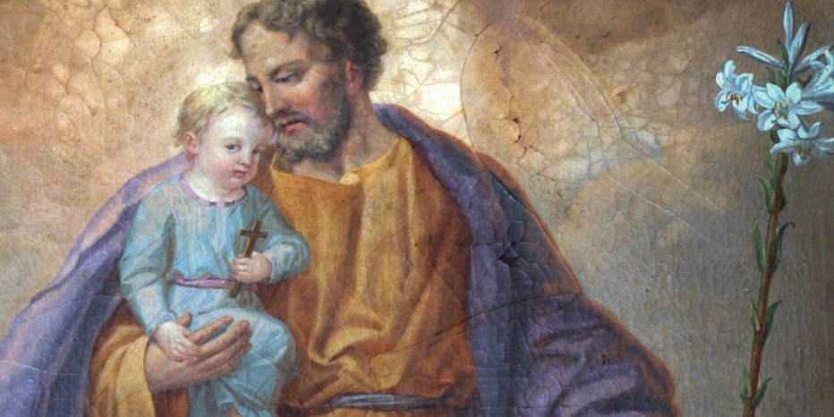
Seven New “Invocations” in the Litany of Saint Joseph
Guardian of the Redeemer
Servant of Christ
Minister of Salvation
Support in Difficulties
Patron of Exiles
Patron of the Afflicted
Patron of the Poor

Slide 8
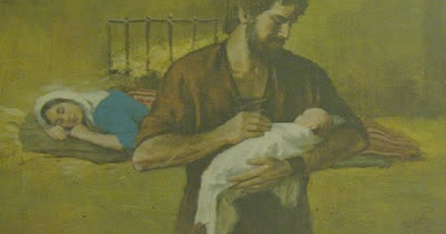
Saint Joseph, pray for us!

